Slide 1

Overviewof Jenkins

Slide 2

Agenda:
1
Continuous Integration
2
Orchestration
3
Jenkins
4
Creating a Job in Jenkins
5
Creating a Jenkins pipeline
6
Jenkins Demo
7
Conclusion
8
References

Slide 3
Continuous Integration
Continuous integration systems are a vital part of any Agile team because they help enforce the ideals of Agile Development.
“Continuous Integration is a software development practice where members of a team integrate their work frequently, usually each person integrates at least daily - leading to multiple integrations per day. Each integration is verified by an automated build (including test) to detect integration errors as quickly as possible” – Martin Fowler

Slide 4
CI – What does it really mean?
At a regular frequency (ideally at every commit), the system is:
Integrated
Built
Tested
Archived
Deployed

Slide 5

CI – Workflow
Code Repository
Artifact Repository
Executable/package
Regular Intervals
Continuous build system /orchestration
Source code and unit tests
Testing Results
Deployment
Test Reports
Developers

Slide 6
CI – The tools
Code Repositories
SVN, Git
Continuous Build Systems or Orchestration tools
Jenkins, Bamboo
Test Frameworks
JUnit, Cucumber
Artifact Repositories
Nexus, Artifactory
For integrating with ALM tools like Collabnet Team Forge, Jira there are rich plugin systems in the CI tools.

Slide 7
Orchestration:
Orchestration is concerned with automating the execution of a workflow – of a process.
A process may be comprised of multiple tasks and involve multiple systems.
Orchestration speeds up the continuous integration process.
Jenkins is an open-source tool used for orchestration

Slide 8
Jenkins
Jenkins is an Open Source, cross-platform, Continuous Integration and Continuous Delivery application that increases your productivity.

Slide 9
Jenkins - History
Jenkins was originally developed as the Hudson project.
Hudson's creation started in summer of 2004 at Sun Microsystems.
It was first released in java.net in Feb. 2005.
In 2009, Oracle purchased Sun Microsystems.
In January 2011, the Hudson developer community decisively voted to rename the project to Jenkins.
On April 20, 2016 version 2 was released with the Pipeline plugin enabled by default.

Slide 10
Jenkins: Features
Easy installation
Easy configuration
Rich plugin ecosystem
Extensibility
Distributed builds
Easy Integration with other ALM tools like Collabnet TeamForge, Jira etc.

Slide 11
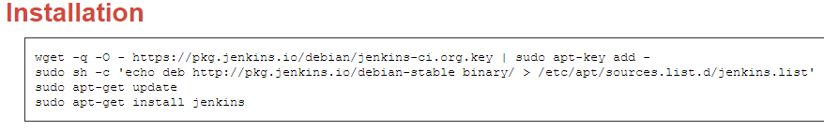
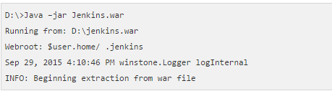
Installation of Jenkins
Jenkins can be installed in two ways
Installing of the Jenkins server on Ubuntu
Download the jenkins.war from https://jenkins.io/
Using the .WAR file of Jenkins in command prompt

Slide 12
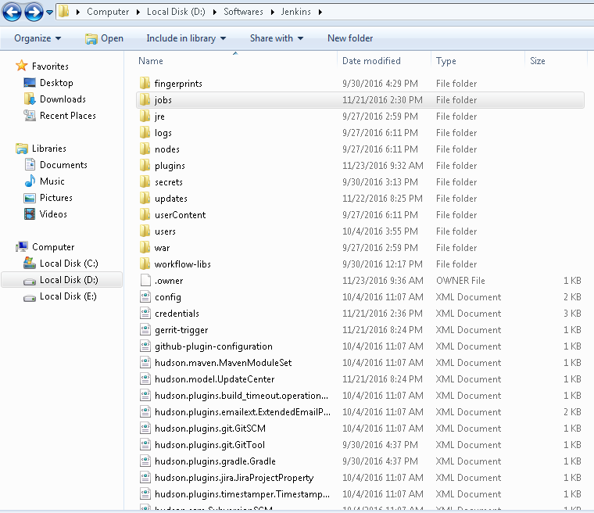
Continued…

Slide 13
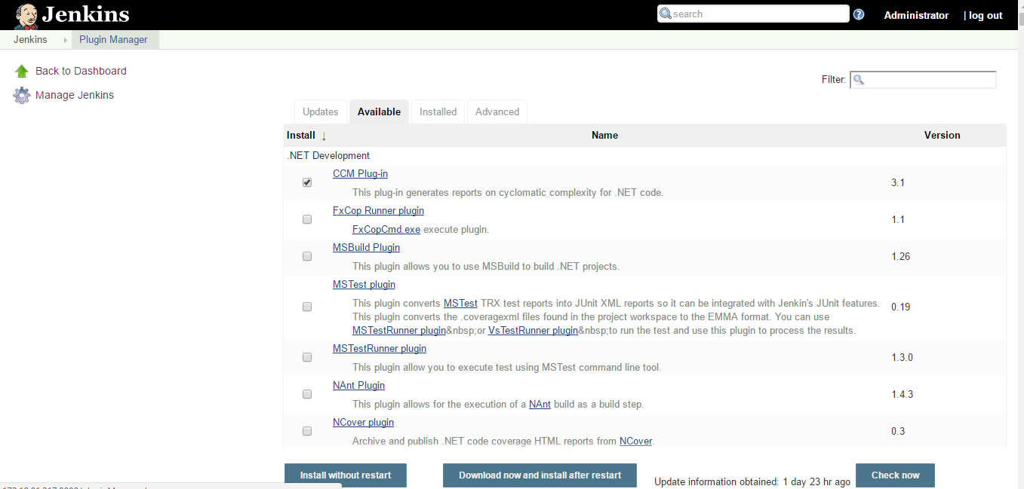
Installing plugins in Jenkins:
Plugins can be installed in Jenkins in two ways:
Go to Manage Jenkins and then Manage Plugins tab
We can install the available plugins listed according to our requirement.

Slide 14
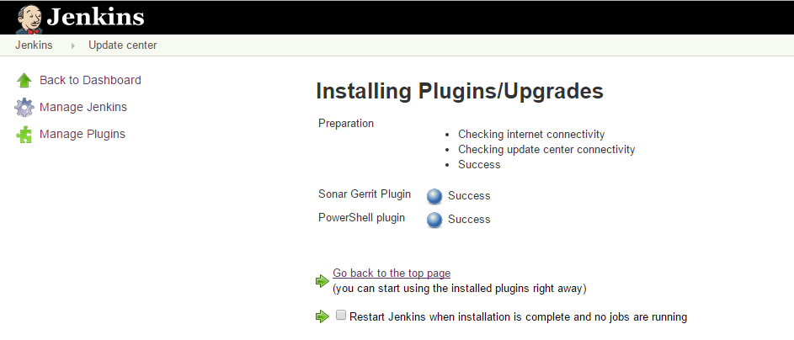
Continued..
Select the plugin you want to install
Click on install without restart
This is the success page for installing Powershell plugin.

Slide 15
Continued..
Now after installing powershell plugin we should be able to run powershell scripts in windows powershell.
Here’s a sample example.
Create a freestyle job named powershell and in its configurations make following changes:
In the Build tab click on Add build step
In the dropdown click on Windows Powershell option(enabled after installing powershell plugin)
Write the following powershell script for getting the current date and time:
$a = Get-Date echo $a
Apply and save
Now build the job using Build Now

Slide 16
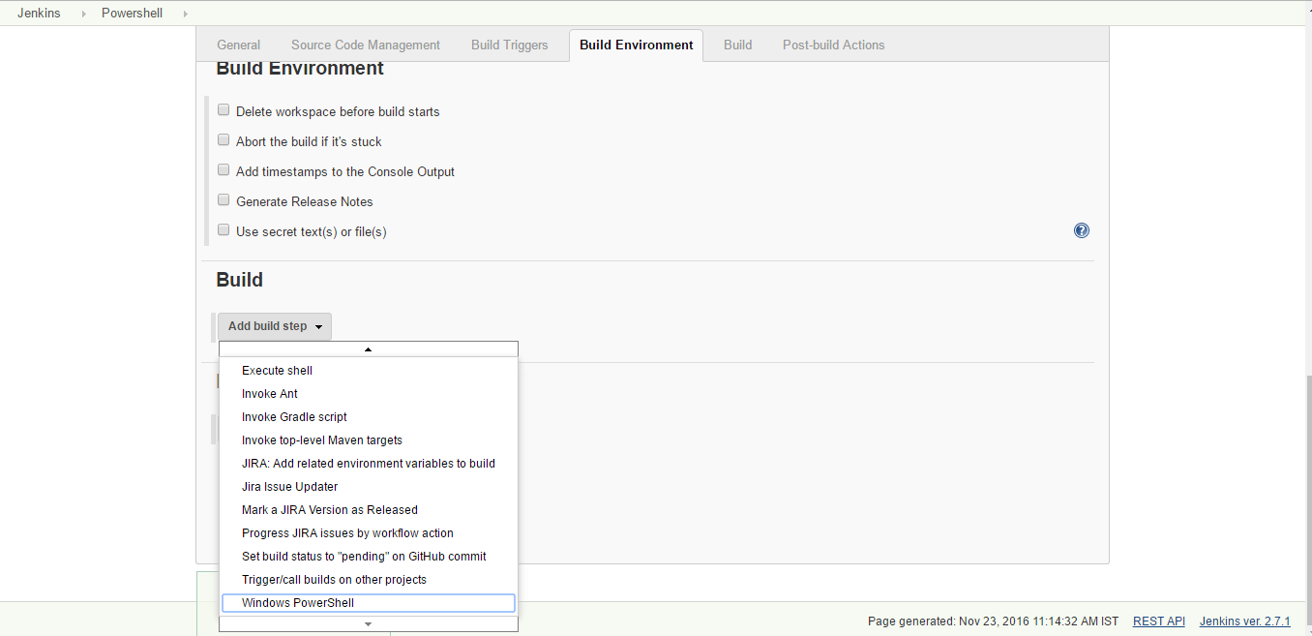
Continued..

Slide 17
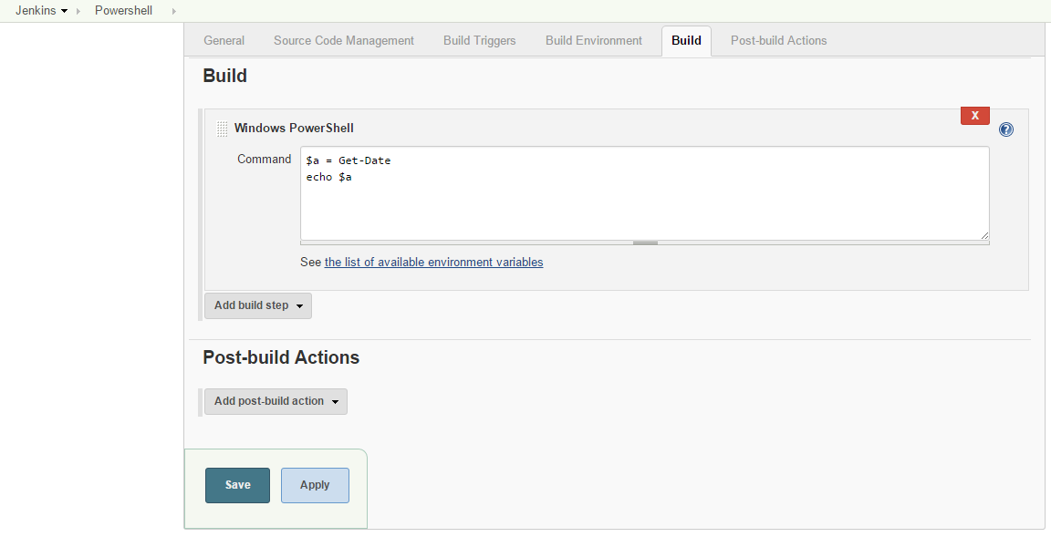
Continued..

Slide 18
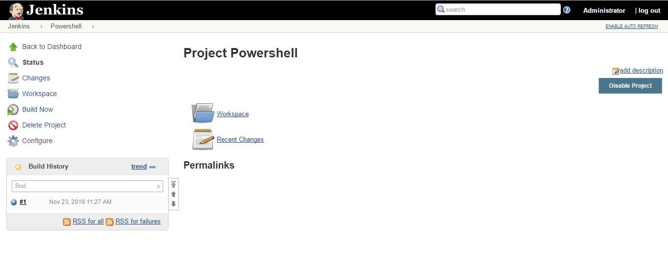
Continued..
After clicking on build now a process with build number in the build history can be seen.
Click on the process to check console output

Slide 19
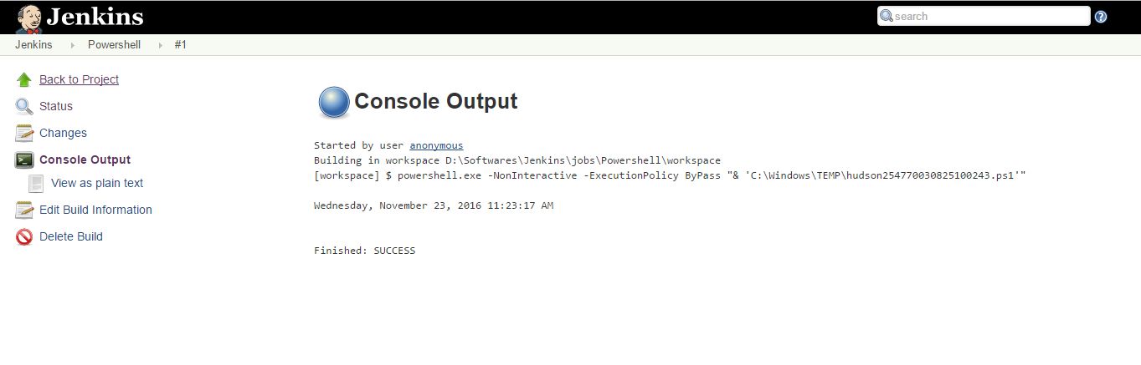
Continued..
The output is the current system date. And the build is successful.

Slide 20
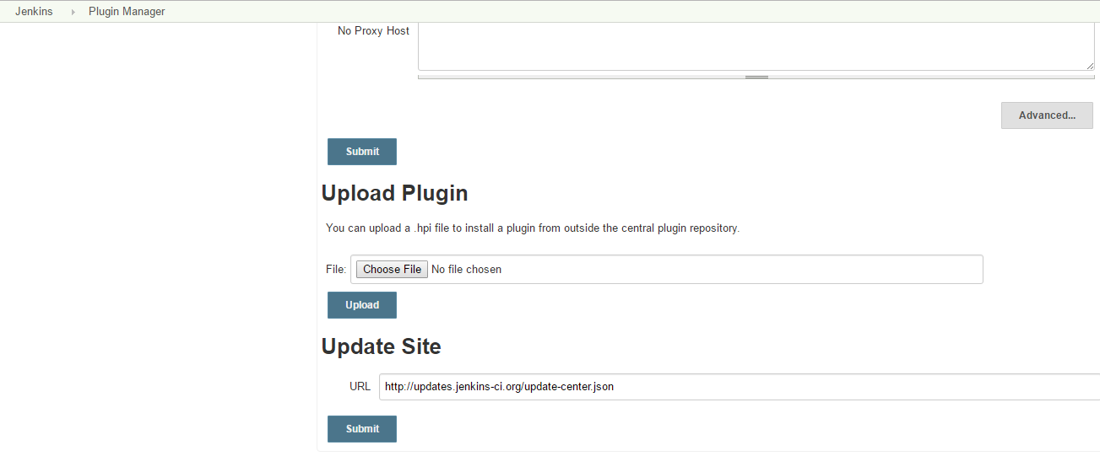
Continued..
2. You can upload a .hpi file to install a plugin from outside the central plugin repository in the advanced tab.

Slide 21
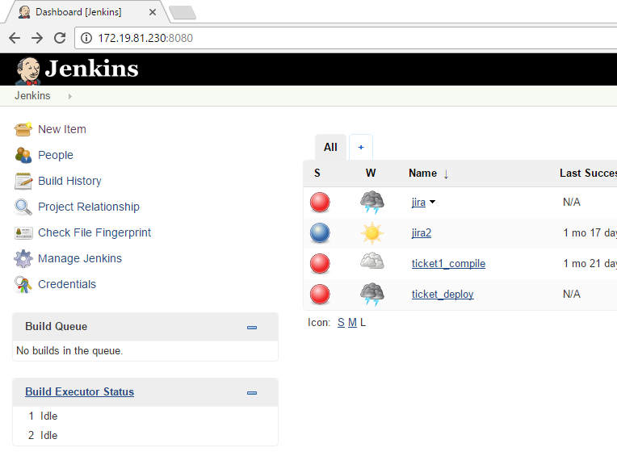
Creating a job in Jenkins
Go to http://localhost:8080 in your browser for using Jenkins
For creating a job click on New Item.

Slide 22
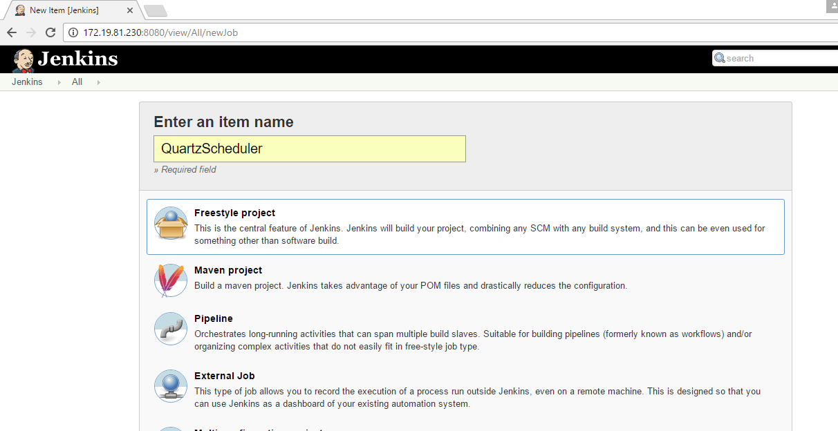
Continued..
Enter a project name and select the type of project.

Slide 23
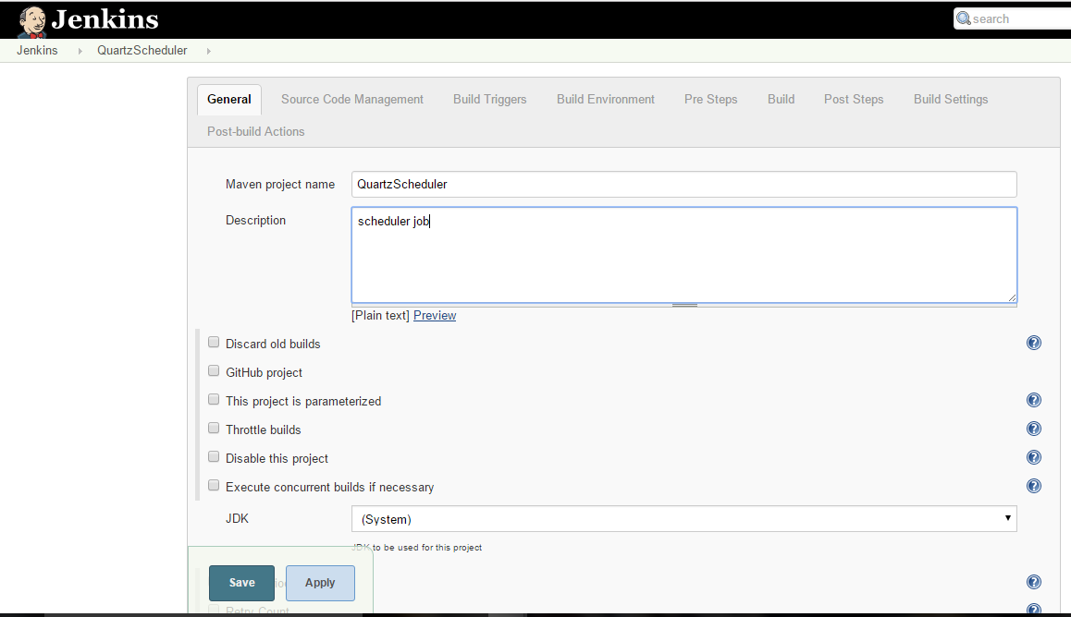
Continued:
Fill in configuration details

Slide 24
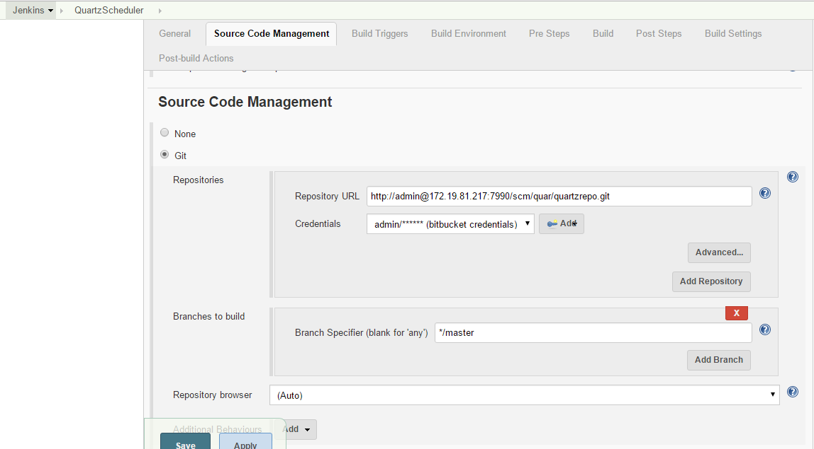
Continued..
For source code management provide the configuration details as shown
Apply your configurations and save

Slide 25
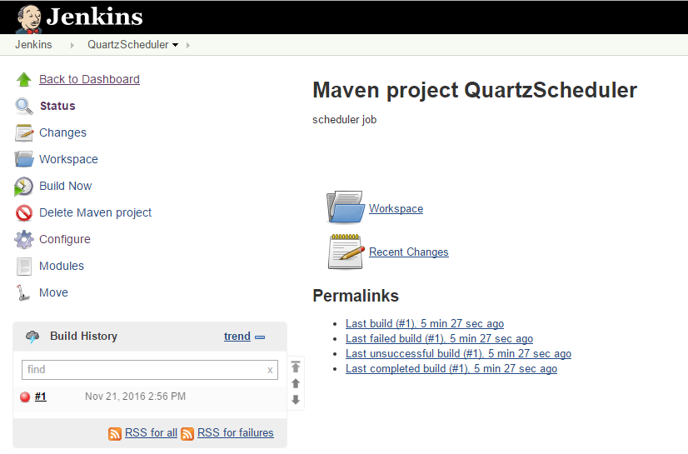
Continued..
Now build the job using the option Build now.
You can check the build details in the build history tab

Slide 26
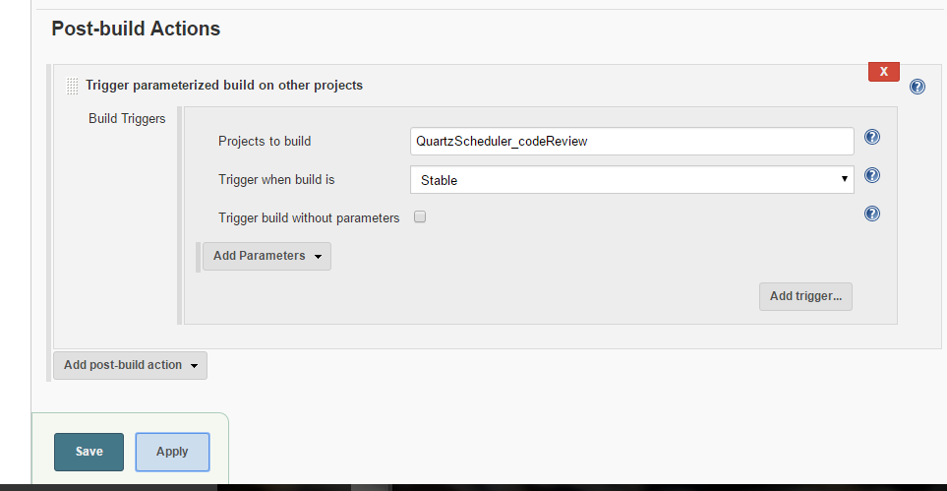
Creating a Jenkins Pipeline
A pipeline will automatically build all the projects in a sequential manner.
Create multiple jobs in Jenkins each having a different functionality.
Now in the first job’s configuration make the following changes:
In the post-build actions select trigger parameterized build on other projects
Give the name of the job that you want to build after first job.
Do the same in the 2nd job with the 3rd job’s name in post-build actions and so on.

Slide 27
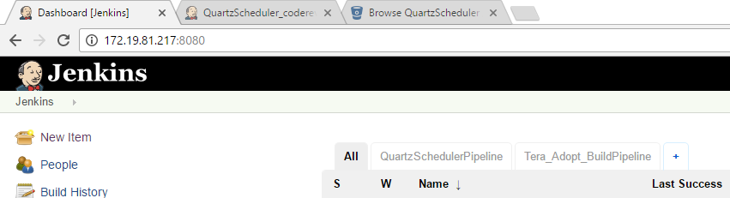
Continued..
For creating the pipeline view click on the + symbol
Select build pipeline view and name the pipeline
Then in the Select Initial Job choose the first job you want to build

Slide 28
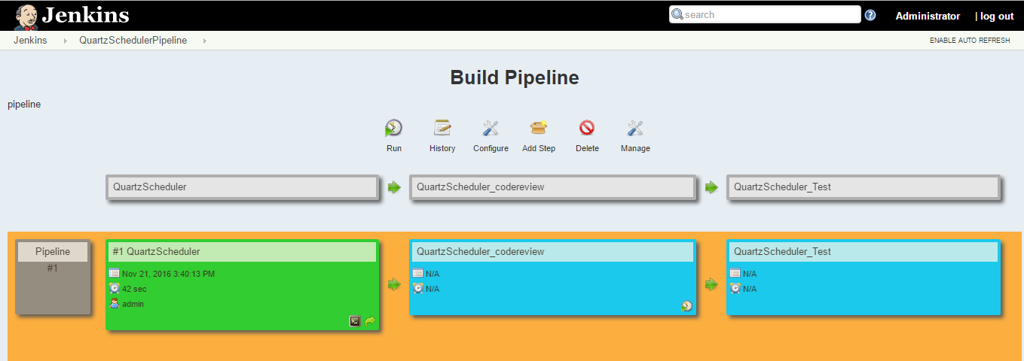
Continued..
The pipeline view :

Slide 29
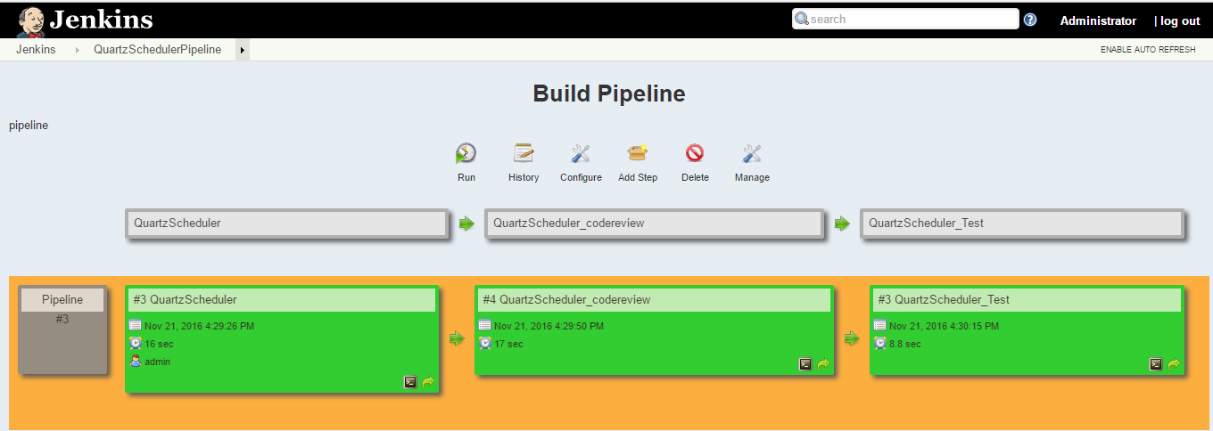
Continued..
Once we run the first job in the pipeline Jenkins does the rest.

Slide 30
Jenkins DEMO

Slide 31
Conclusion
Continuous integration is a necessity on complex projects due to the benefits it provides regarding early detection of problems.
A good continuous build system should be flexible enough to fit into pre-existing development environments and provide all the features a team expects from such a system.
Jenkins, a continuous build system, can be an integral part of any continuous integration system due to it’s core feature set and extensibility through a plugin system.

Slide 32
References
Continuous Integration – Martin Fowler
http://www.martinfowler.com/articles/continuousIntegration.html
Hudson
http://hudson-ci.org/
Hudson Continuous Integration Server
http://www.code-magazine.com/articleprint.aspx?quickid=0906071&printmode=true
The Hudson Book
http://www.eclipse.org/hudson/the-hudson-book/book-hudson.pdf
Jenkins
https://wiki.jenkins-ci.org
Monkey Image
http://corrines-corner2006.blogspot.com/2011/09/freebie-monday_26.html

Slide 33
Thank You
Look forward to engaging you on areas of interest!

